Slide 1

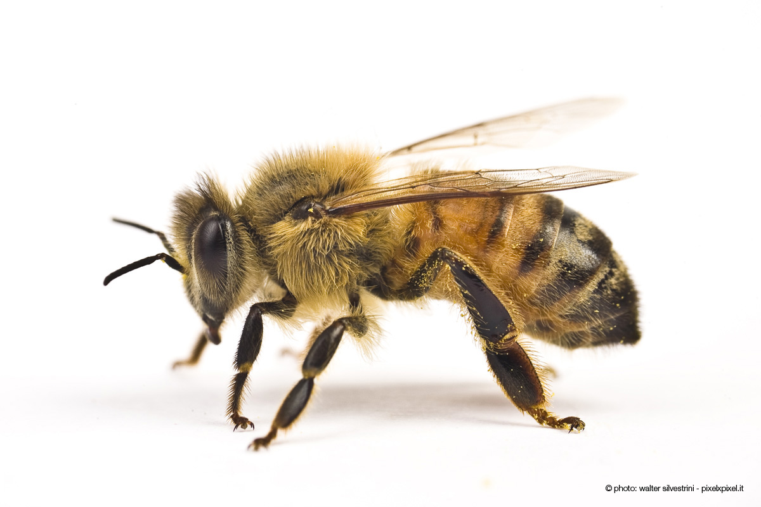
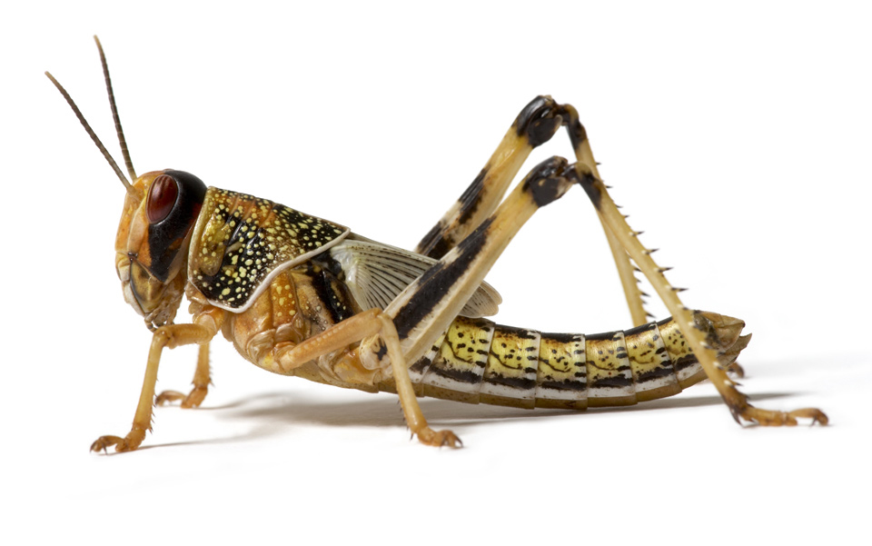
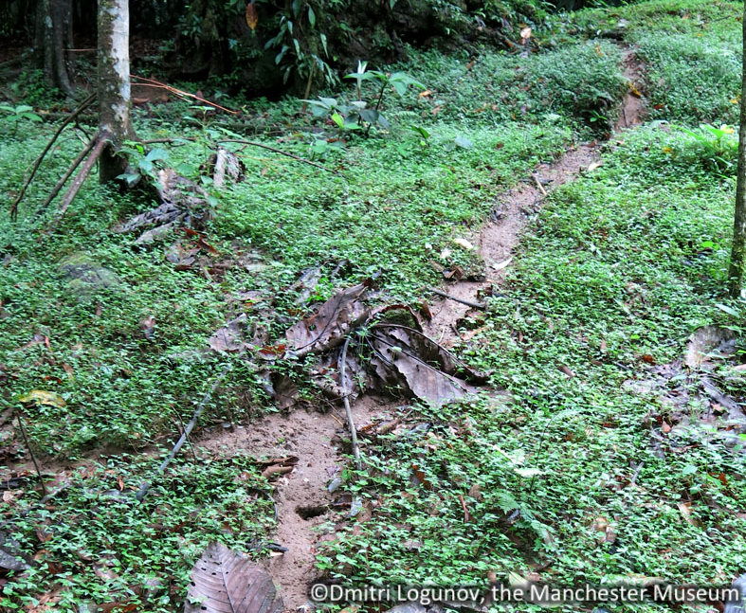
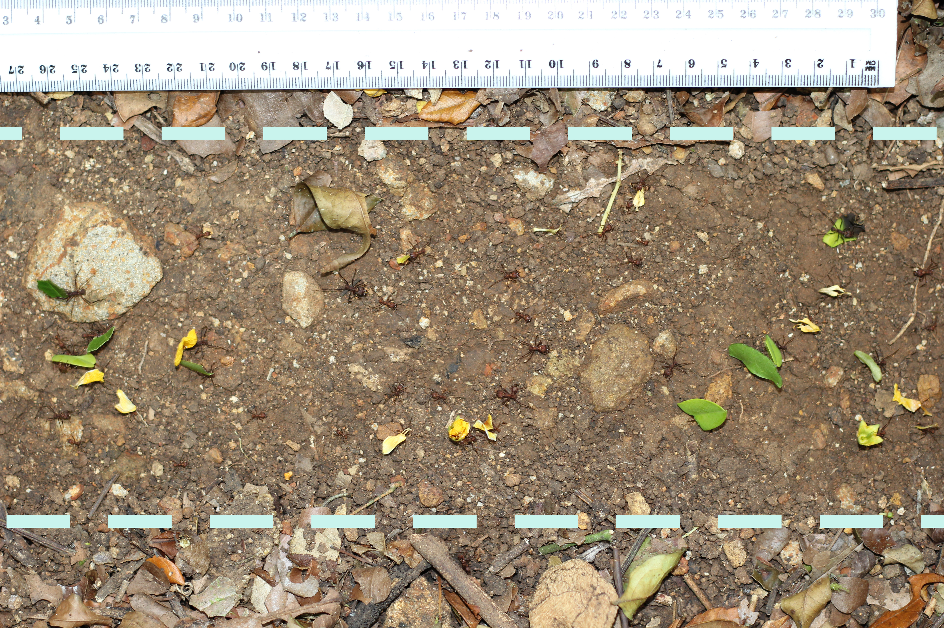
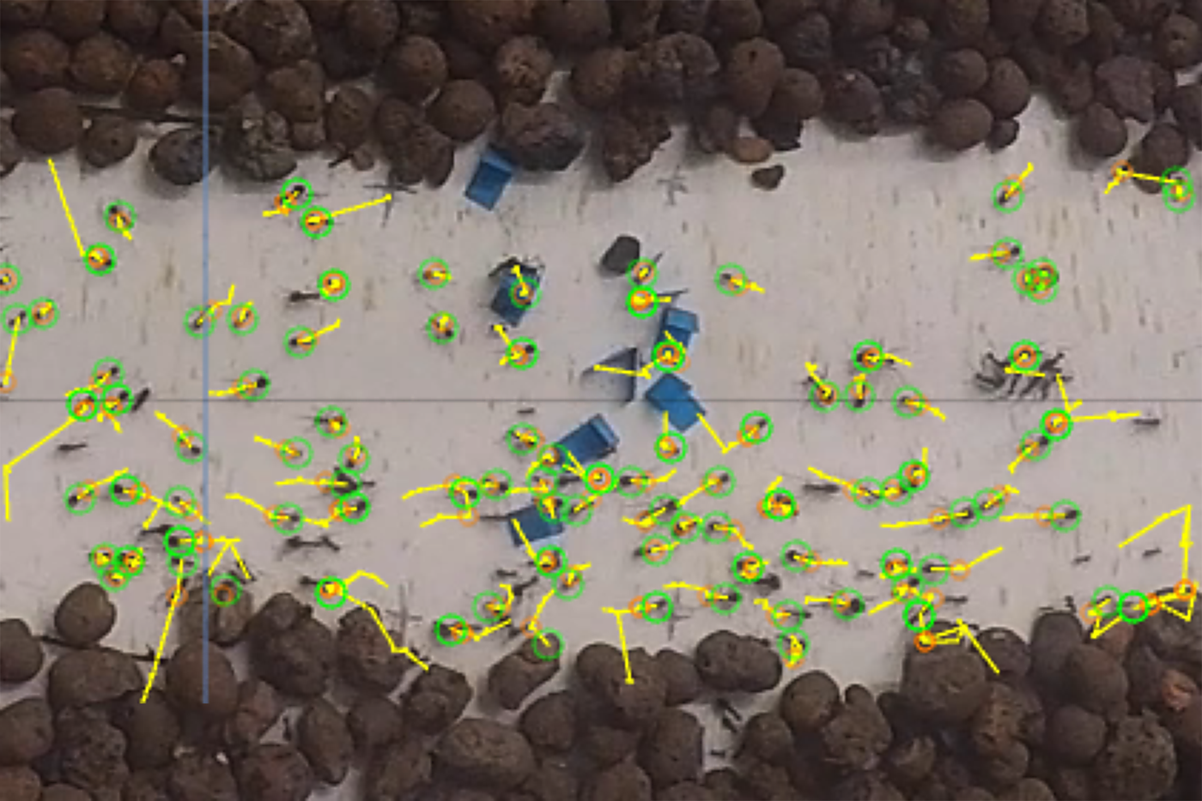
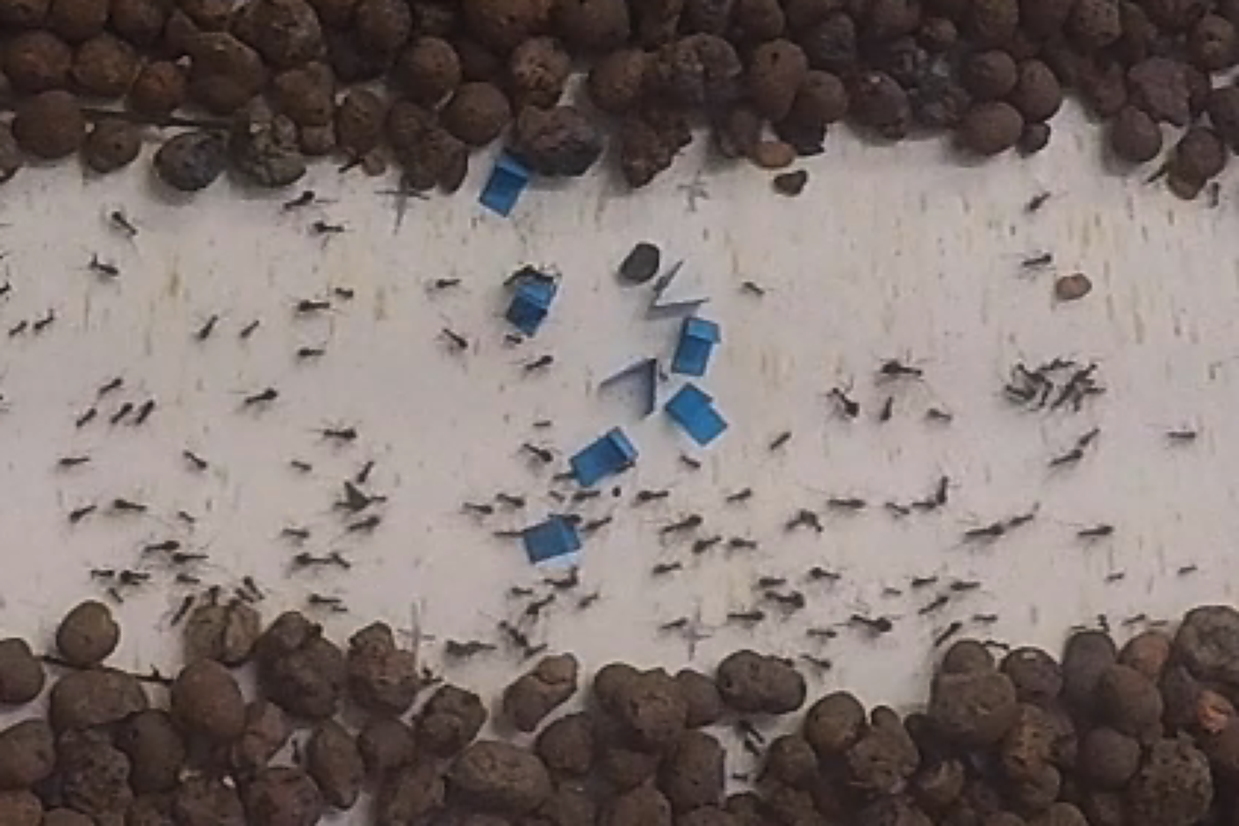
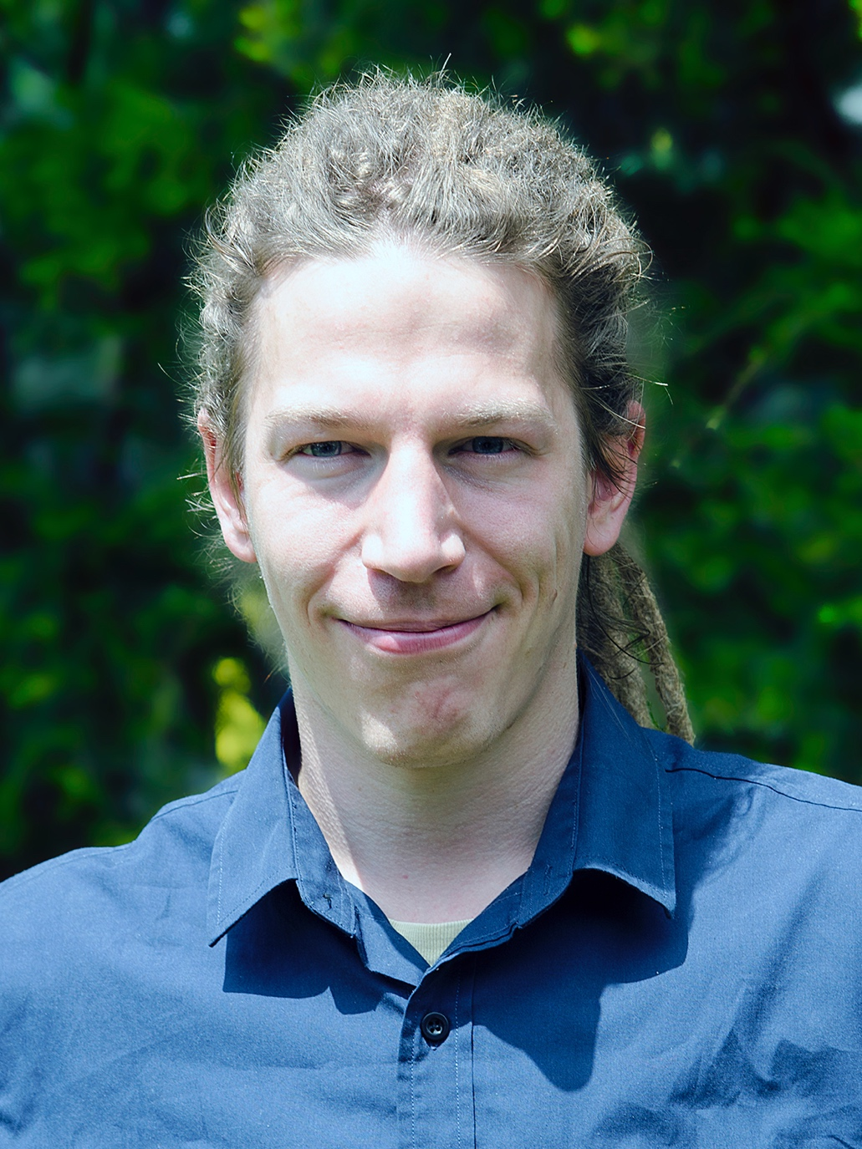

UNDERSTANDING AND PREDICTING SWARMS
Thomas Bochynek, Monash University
Thomas.Bochynek@monash.edu
Why care about swarms?
Insect swarms play a significant environmental role: as pollinators; crop pests; soil turners; or as invaders, damaging local biodiversity.
Beyond environmental considerations, they have an impact on the producing industry: bees pollinate most commercial crops; locusts damage farmland and cattle grazing ground; ants interfere with livestock production and farming.
$
$
$
240Bn / year
Crop production world wide
1Bn / year
Damages in Australia
2Bn / year
Damages in the USA
¹
²
³
What is the challenge?
Ant highway carved through rainforest undergrowth. Trail construction is self-organised, without planning staff or centralised knowledge about the environment
Despite small body size and limited intelligence of individual insects, swarms of insects show highly complex behaviour. This unexpected complexity from limited individuals is termed “swarm intelligence”. It is hard to predict swarm behaviour based solely on the understanding of the behaviour of an individual.
The challenge is to build mathematical models that capture this complexity for the prediction of swarm behaviour.
In my research, I investigate self-organised infrastructure construction behaviour in American leaf-cutter ants.
How to decipher swarm behaviour? – Infrastructure construction in Ants
Under what conditions are the above trails built? How does a swarm without central intelligence make these decisions? To answer these questions, I artificially obstruct cleared trails and build mathematical models based on the swarm response.
From Nature …
… to Data …
… to Mathematical Models
Based on observations in nature, I conduct laboratory experiments to trigger road clearing behaviour:
From experiment and field recordings, I extract behavioural data via image tracking and visualisation techniques:
By matching observations of trail clearing with conditions under which they occur, I build stochastic models of the swarm’s trail clearing behaviour:
Observation of cleared trail in nature
Tracking of ant position and speed
Matching simulation to behavioural data, showing gradual process of trail clearing
As a result of my research, I can predict occurrence and location of swarm level infrastructure construction.
The tools I develop are tailored to this behaviour – but the methods used are applicable to understanding a wide range of swarming species and behaviours.
Simulated cleared trail with obstructions in the laboratory
Visualisation and measurement of ant density over time
FOR FURTHER INFORMATION
Thomas Bochynek
Thomas.Bochynek@monash.edu
www.ThomasBochynek.com
References
Nicola Gallai, Jean-Michel Salles, Josef Settele, Bernard E. Vaissière: Economic valuation of the vulnerability of world agriculture confronted with pollinator decline. Ecological Economics (2008), doi:10.1016/j.ecolecon.2008.06.014.
Millist, Nicola, and Ali Abdalla. "Benefit–cost analysis of Australian plague locust control operations for 2010–11." ABARES report prepared for the Australian Plague Locust Commission (2011).
Pimentel, David, et al. "Environmental and economic costs of nonindigenous species in the United States." BioScience 50.1 (2000): 53-65.
Acknowledgements
This project is supervised by Bernd Meyer (Monash, IT) and Martin Burd (Monash, Science). We thank our cooperator Christoph Kleineidam at the University of Konstanz, Germany, and DATA61 | CSIRO for additional funding.

